Slide 1
COMPREHENSIVE DIGITAL MARKETING PROJECT
WORK ON ICICI BANK

Slide 2
TEAM MEMBERS
Team ID : LTVIP2023TMID09200
Team Leader : CHINTADA SRAVANI
Team member : DIKSHIT JAIN
Team member : DOULAPILLI HEMANTHKUMAR
Team member : CHALLA LALITHAPRIYA
Team member : BOYE RAJESH

Slide 3
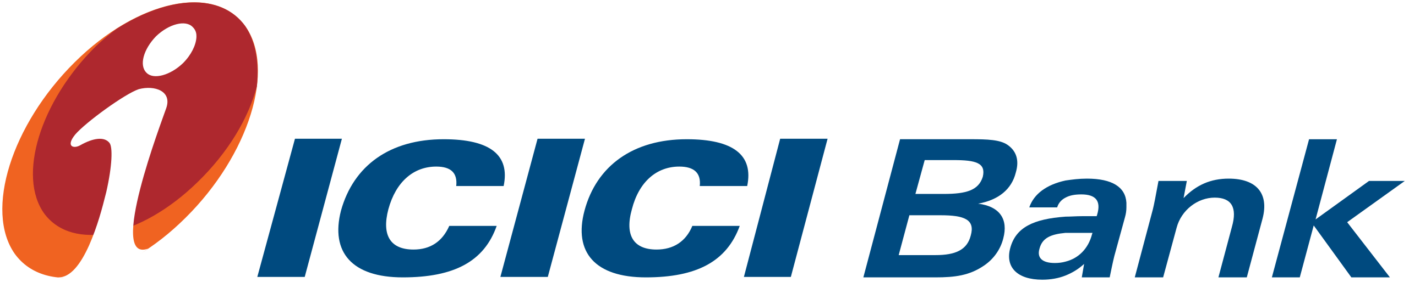
Part 1: Brand study, Competitor Analysis & Buyer’s/Audience’s Persona
Brand : ICICI BANK
Website: https://www.icicibank.com/
Brand Colors: Orange, Black, Grey
Brand Logo:
USP:
ICICI Bank is one of India's premier private sector banks, established in 1994. It offers a wide range of financial services, including retail and corporate banking, wealth management, insurance, and investment services.
Mission/Values:
To provide the best quality of products and services and to attract the people with new technology
and effective response by which ICICI bank can become 1st priority of choice to customers.
Vision: To become world wide best financial service provider and major global bank.
Tagline: "Khayaal Aapka" (Your Thoughtfulness) - This slogan emphasizes ICICI Bank's commitment to understanding and meeting its customers' needs and preferences.

Slide 4
Part 1: Brand study, Competitor Analysis & Buyer’s/Audience’s Persona
Analyse Brand Messaging:
ICICI encourages its customers with technology, speed and financial capital to be in the leading financial services provider in India. ICICI bank aims to grow strategically by platforms and offering seamless journeys to customers. Six value drivers from the crux of the bank’s strategy in delivering services to customers.
Examine the brand's tagline:
“For those who always want something extra”. The ICICI bank always provides extra benefits and services to the customers.
“Hum Hai Na”. Which means We are always there for you.
ICICI provides 24/7 services to the customers.
"Khayaal Aapka" (Your Thoughtfulness) - This slogan emphasizes ICICI Bank's commitment to understanding and meeting its customers' needs and preferences.

Slide 5

Part 1: Brand study, Competitor Analysis & Buyer’s/Audience’s Persona
Competitor 1: SBI BANK
State Bank of India (SBI) is the largest public sector bank in India, tracing its roots back to 1806. It offers a vast range of banking services, including retail and corporate banking, personal and business loans, insurance, and investment products. SBI's extensive branch network and customer-oriented approach have contributed to its status as a trusted banking institution in the country.State Bank of India is one of the most trusted bank in India as it is a Government owned public sector bank. It has wide range of branch network across India. It focuses on financial inclusion and social initiatives
Website: https://www.onlinesbi.sbi/
USP: It offers a vast range of banking services, including retail and corporate banking, personal and business loans, insurance, and investment products.
Communication: SBI's extensive branch network and customer-oriented approach have contributed to its status as a trusted banking institution in the country.

Slide 6

Competitor 2 : HDFC
HDFC Bank is one of India's leading private sector banks, founded in 1994. It is known for its customer-centric approach, offering a diverse range of banking products and services, including retail and wholesale banking, credit cards, loans, and insurance. The bank has earned a reputation for its efficient service delivery and a wide distribution network across the country.
Website: https://www.hdfcbank.com
USP: It is known for its customer-centric approach, offering a diverse range of banking products and services, including retail and wholesale banking, credit cards, loans, and insurance. The bank has earned a reputation for its efficient service delivery and a wide distribution network across the country.
Communication: Engaging Social Media Presence, branch network and customer-oriented approach have contributed to its status as a trusted banking institution in the country.

Slide 7

Competitor 3: AXIS BANK
It is one of the best chosen bank by the customers.Axis bank is maintaining its asset quality steady. From past 10 years it has highest rate and best service provider.Axis Bank, established in 1993, is a prominent private sector bank in India. It provides a comprehensive suite of financial products and services, encompassing retail and corporate banking, wealth management, and treasury operations. With a commitment to innovation, Axis Bank has introduced various digital initiatives to enhance customer experience and convenience.
Website: https://www.axisbank.com/
USP: A prominent private sector bank with a reputation for personalized banking experiences, a comprehensive product suite, and a strong emphasis on cutting-edge technology.
Communication: Signifies Axis Bank's dedication to helping customers achieve progress and growth in their lives through innovative banking products and services.

Slide 8
Part 1: Brand study, Competitor Analysis & Buyer’s/Audience’s Persona
Buyer's/Audience's Persona:
Demographics:
Age: ICICI Bank caters to a wide age range, including young adults, middle-aged adults, and seniors.
Gender: The bank provides financial services for both males and females.
Income Level: ICICI Bank targets consumers from diverse income levels, from those needing basic banking services to affluent individuals requiring premium banking products.
Psychographics:
Financially Savvy: ICICI Bank appeals to individuals who are knowledgeable about personal finance and are seeking efficient financial solutions for their needs.
Security Conscious: The bank targets customers who prioritize the security of their financial transactions and personal data.
Convenience Seekers: ICICI Bank attracts customers who value the convenience of digital banking, including online transactions, mobile banking, and other remote services.
Investment Oriented: The bank appeals to individuals who are investment-oriented, seeking opportunities for wealth growth and management.

Slide 9
Behaviors:
Repeat Customers: ICICI Bank has a loyal customer base, with many consumers utilizing their banking and financial services over a prolonged period.
Occasional Customers: The bank also services occasional customers who require their services for specific transactions or investment opportunities.
Digital Banking Users: ICICI Bank targets consumers who prefer the convenience of online banking, in addition to its physical branch customers.
Brand Awareness: ICICI Bank appeals to customers familiar with the bank's long-standing reputation and robust financial offerings.
Interests:
Financial Growth: The bank attracts customers interested in financial growth, offering diverse investment opportunities and wealth management services.
Tech-Savvy Individuals: ICICI Bank appeals to those who are comfortable using technology for their banking needs, offering a seamless digital banking experience.
Overall, ICICI Bank's target audience: includes a broad range of demographics, from young adults to seniors, and from different income levels. The bank focuses on catering to the diverse financial needs of its customers, from those requiring basic banking services to individuals seeking sophisticated investment options. ICICI Bank's long-standing reputation, wide array of services, and emphasis on digital convenience make it an attractive choice for a variety of customer segments.

Slide 10
Part 2: SEO & Keyword Research
SEO Audit: Analyze ICICI Bank's website for SEO issues, including site architecture, backlinks, content, meta tags, and performance.
Keyword Research: Identify relevant keywords through brainstorming, using research tools like SEMrush, examining competitor keywords, and exploring long-tail keywords related to banking and financial services. http://www.icicibank.com
On-Page Optimization: Enhance meta tags and content with chosen keywords for better search engine visibility and user experience.
Reflections: Conducting SEO for ICICI Bank is complex due to its vast services. The challenge is finding high-volume, low-competition keywords in a competitive sector. The solution lies in targeting specific, long-tail keywords with high conversion potential. The process reveals that users have specific queries which, when addressed effectively, can improve visibility and user experience.

Slide 11
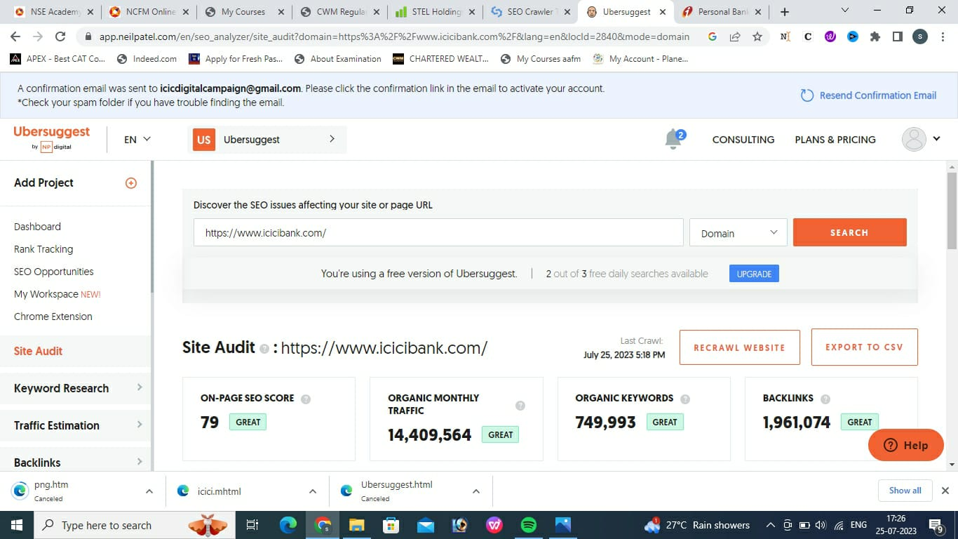
SEO Audit: website: ubersuggest.com

Slide 12
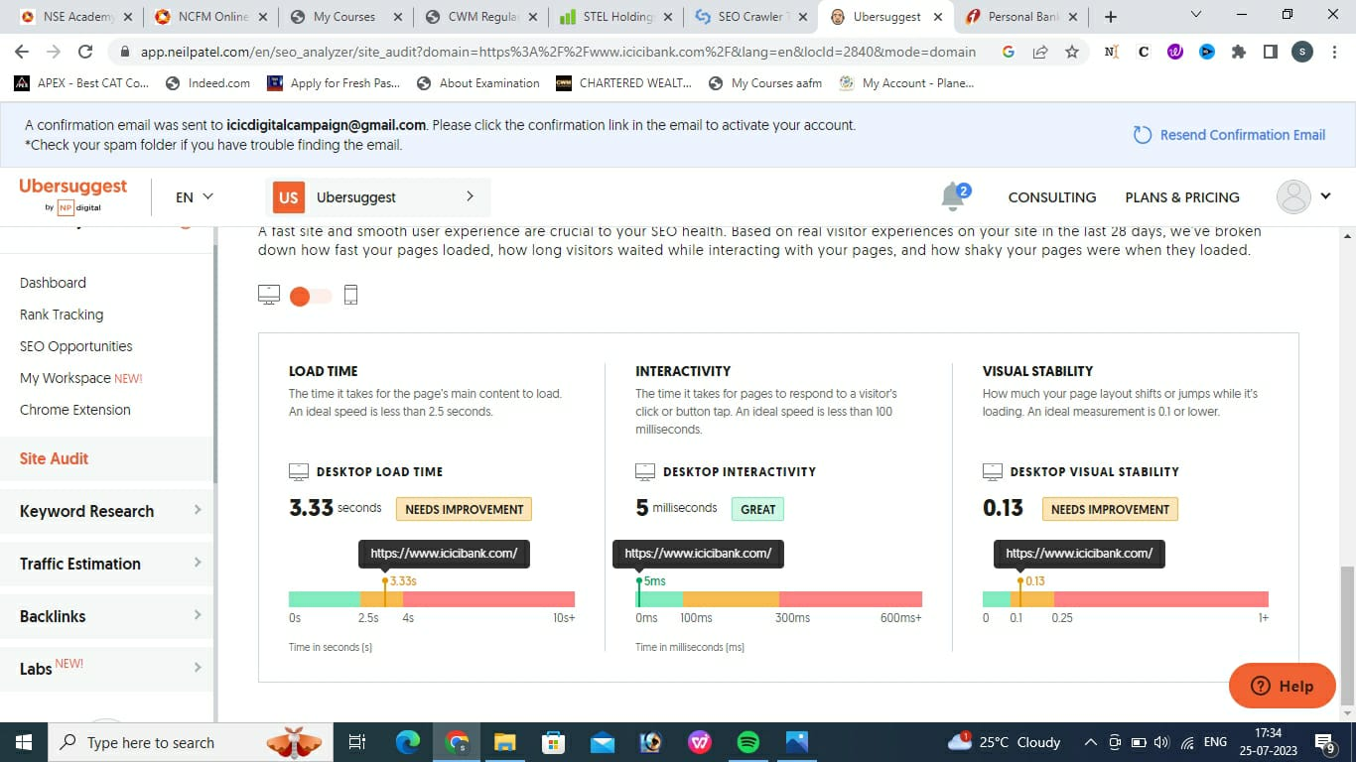
SEO Audit: website: ubersuggest.com

Slide 13
The site audit for www.icicibank.com indicates that on page SEO score is healthy which generates monthly organic traffic og 1.4 million users Meta title test -Personal Banking & Netbanking Services Online - ICICI Bank. This webpage uses a title tag with the length of 48 characters. While there's is no target numbers of characters,title should be descriptive and concise. We recommend using a title between 20 to 60 characters to fit Google search results with 529 pixel limit. Meta description test -ICICI Bank offers a wide range of personal and business banking products and services including accounts & deposits, cards, loans, insurance, and investment products.Mere recommend using a title up till 160 characters to fit Google search results at 920 pixel.Meta title description test results 967 pixel long.
SEO Audit Summary:

Slide 14
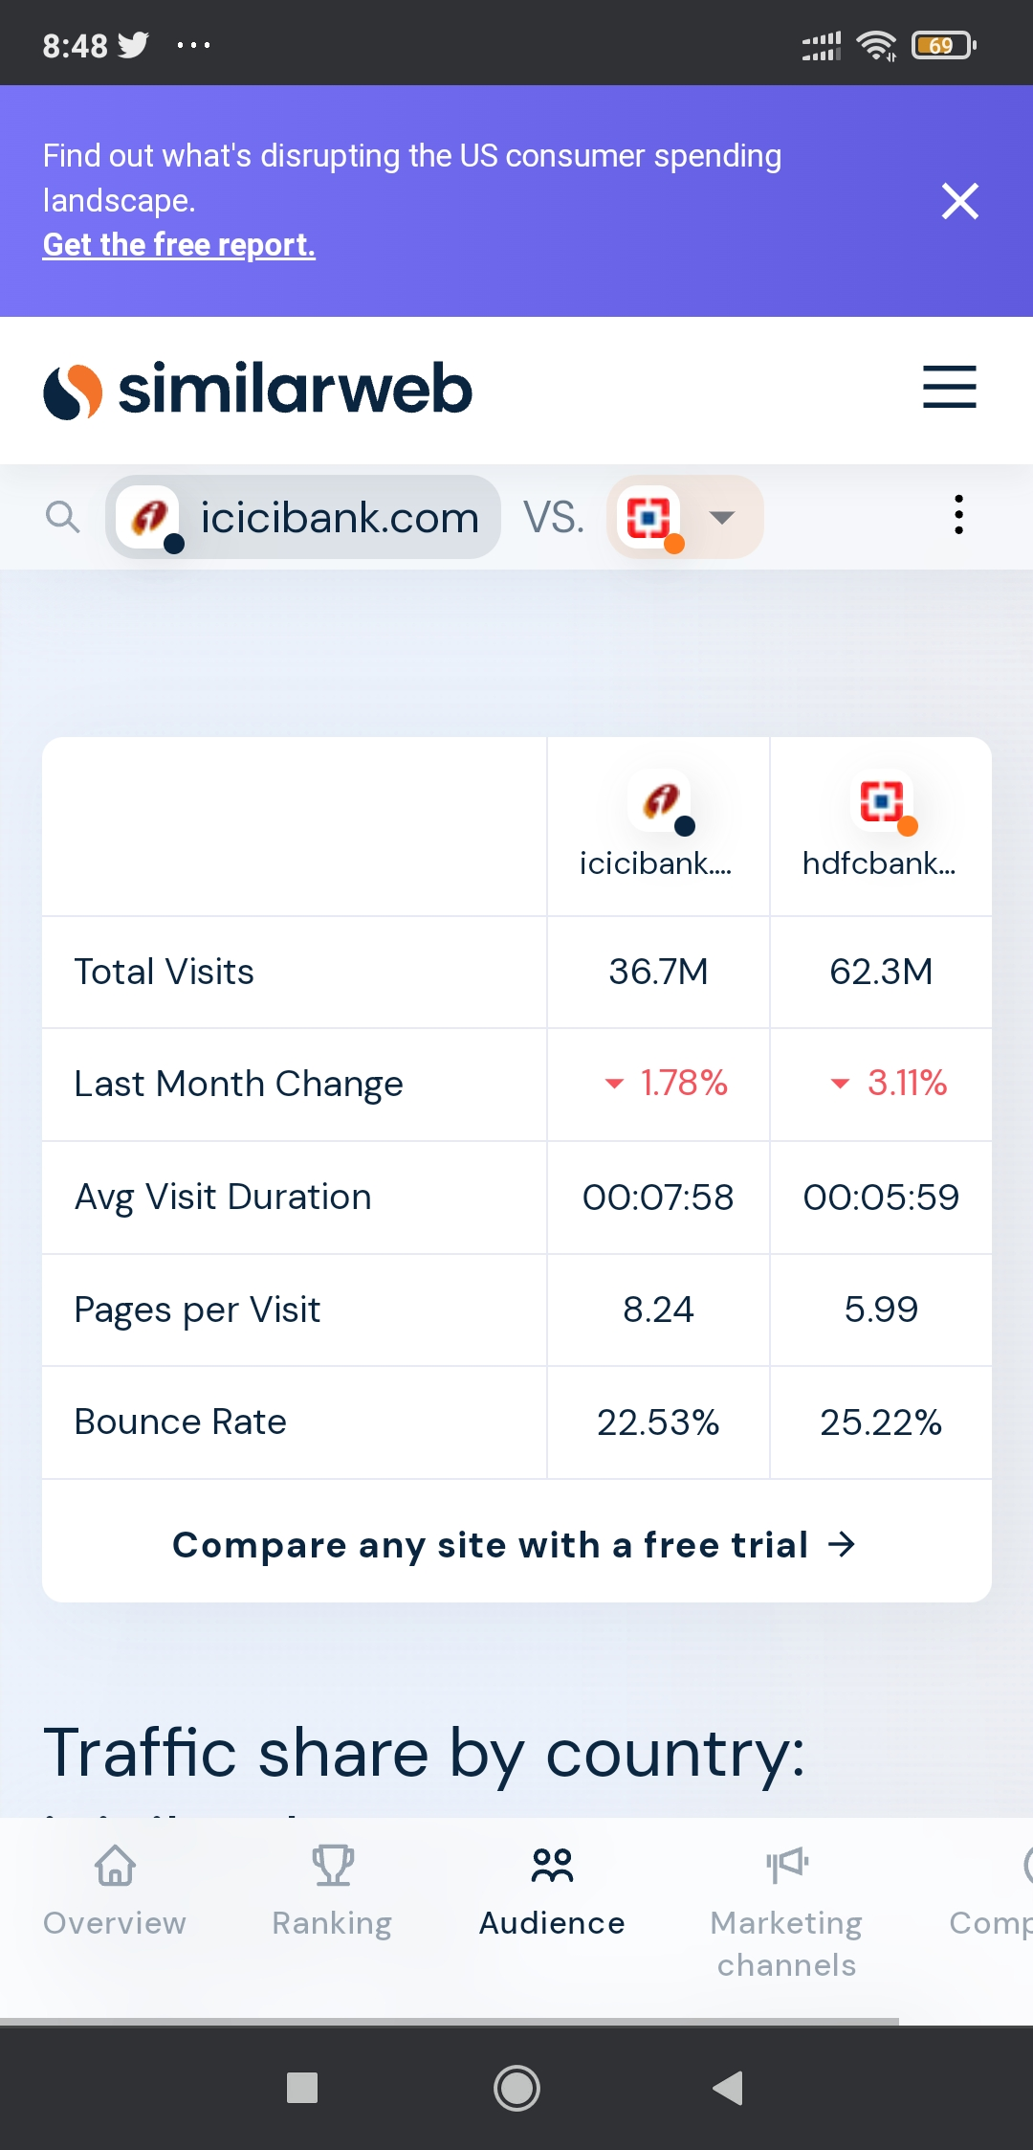
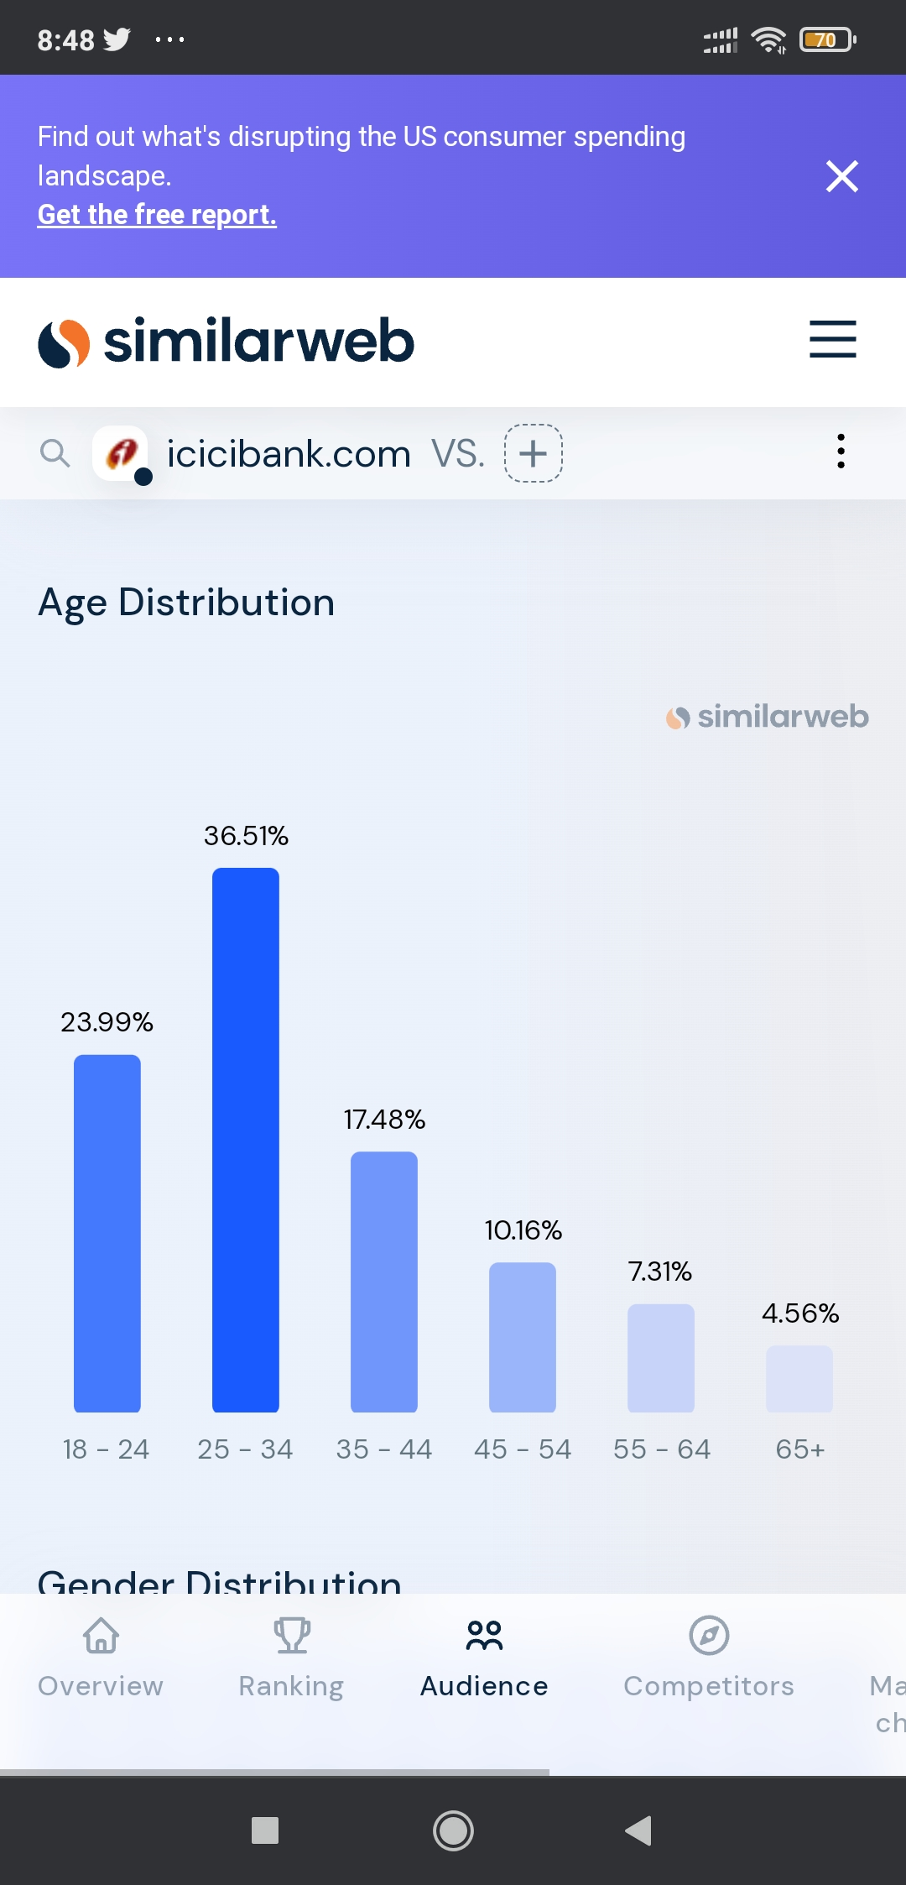
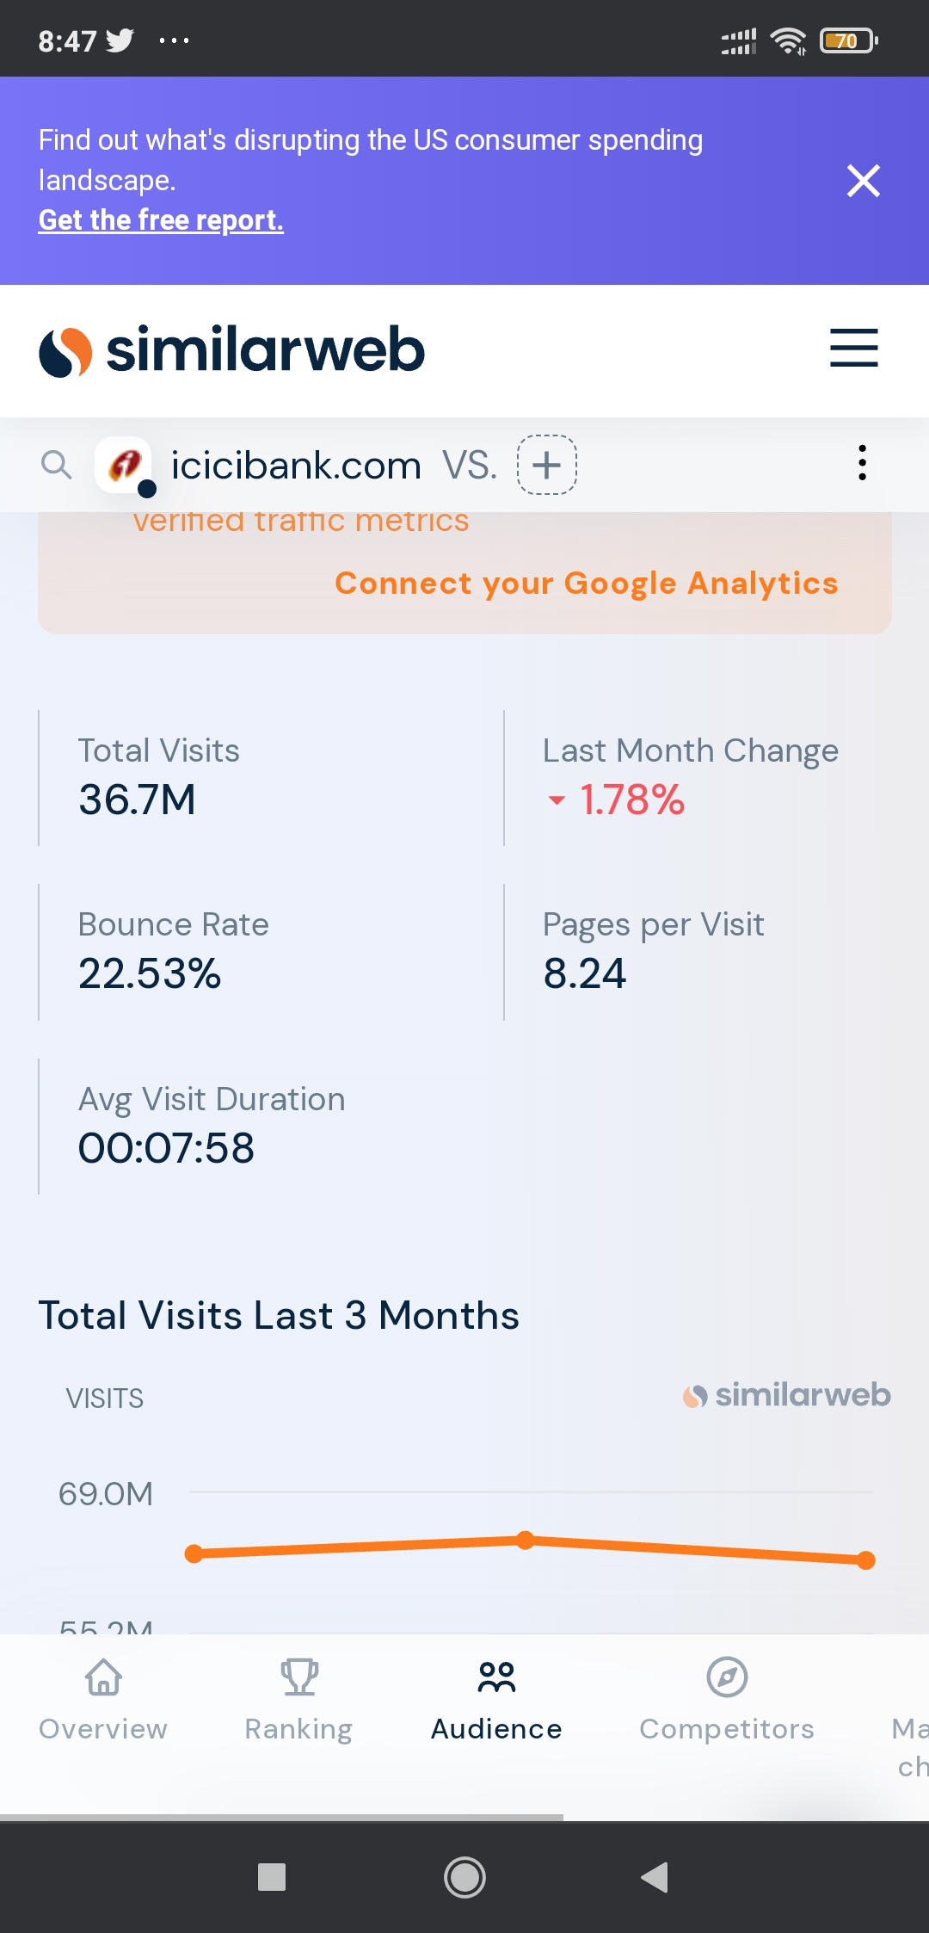
Site Comparision Analysis
Age Distribution
User Analysis

Slide 15
Keyword Research: website: ubersuggest.com
Objective of Keyword Research for ICICI Bank:
Boost organic search visibility and traffic.
Understand customer search habits.
Analyze competitor keyword strategies.
Plan and create relevant, keyword-rich content.
Improve local SEO for branches and ATMs.
Seed Keywords for ICICI Bank:
ICICI Bank login
Bank login ICICI
Bank expressions credit card
Net Banking ICICI
Calculator for EMI
Personal loan
Near by me ATM
Personal loan interest rate lowest
Personal loan interest rate low
Personal loan interest rate average

Slide 16
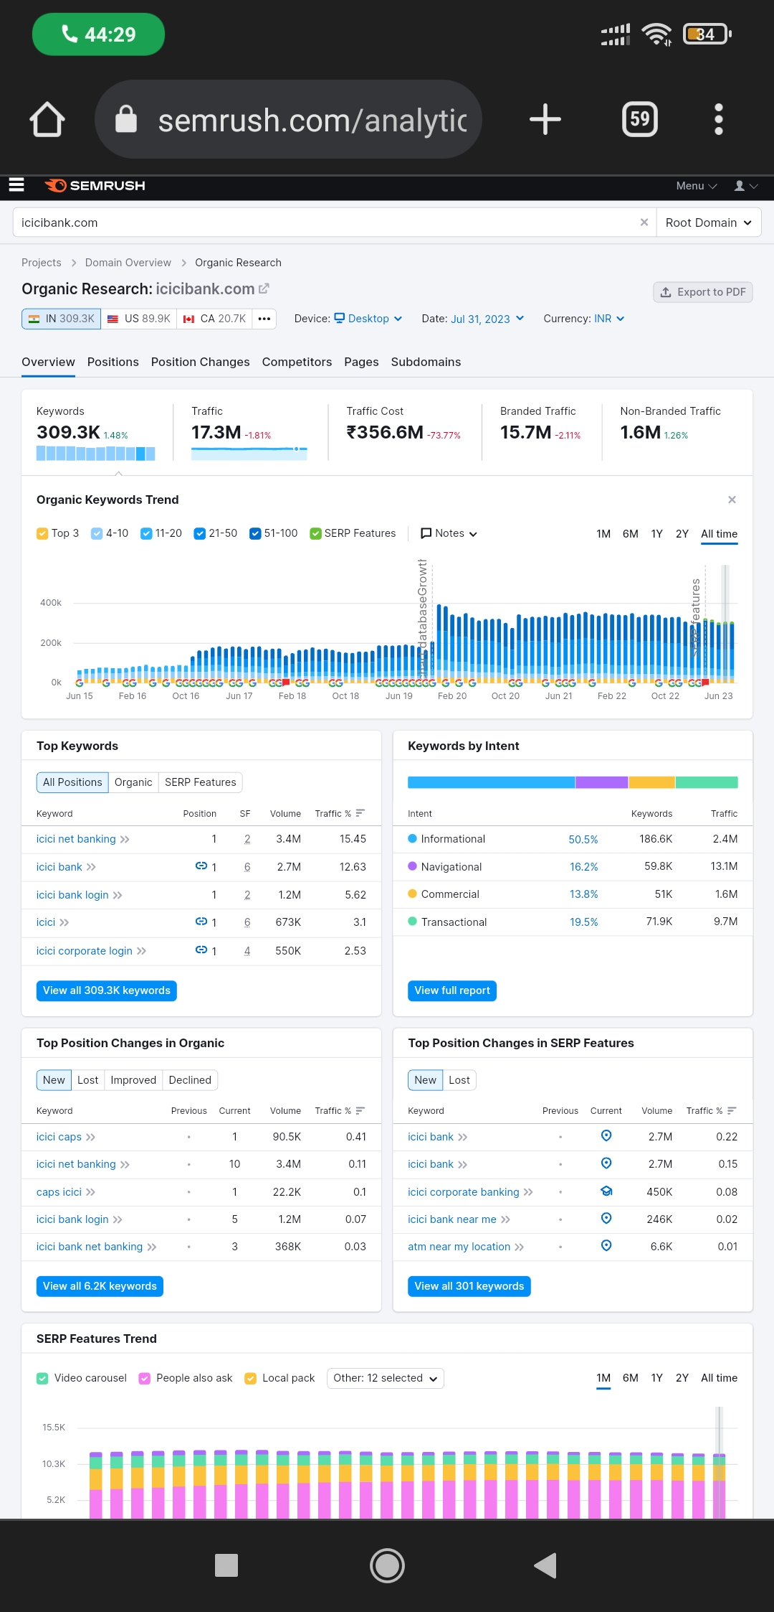
Key Insights:
1. 'ICICI net banking' has a high search volume (1.5 million) and relatively low CPC and PD values, making it potentially attractive for advertising.
2. 'icici bank' has a high CPC indicating high competition and cost for PPC campaigns.
3. 'icici' has a significant search volume and a relatively high CPC, making it potentially valuable for banks targeting customers.
4. 'icici login' and loan Services' have high PD values, indicating high competition in paid advertising.
5. When selecting keywords for ICICI Bank, a balance should be considered between search volume, competition level (both paid and organic), and relevance to the banking services.
The data consists of search volume, CPC (Cost Per Click), PD (Paid Difficulty), and SD (SEO Difficulty) for each keyword.
.

Slide 17
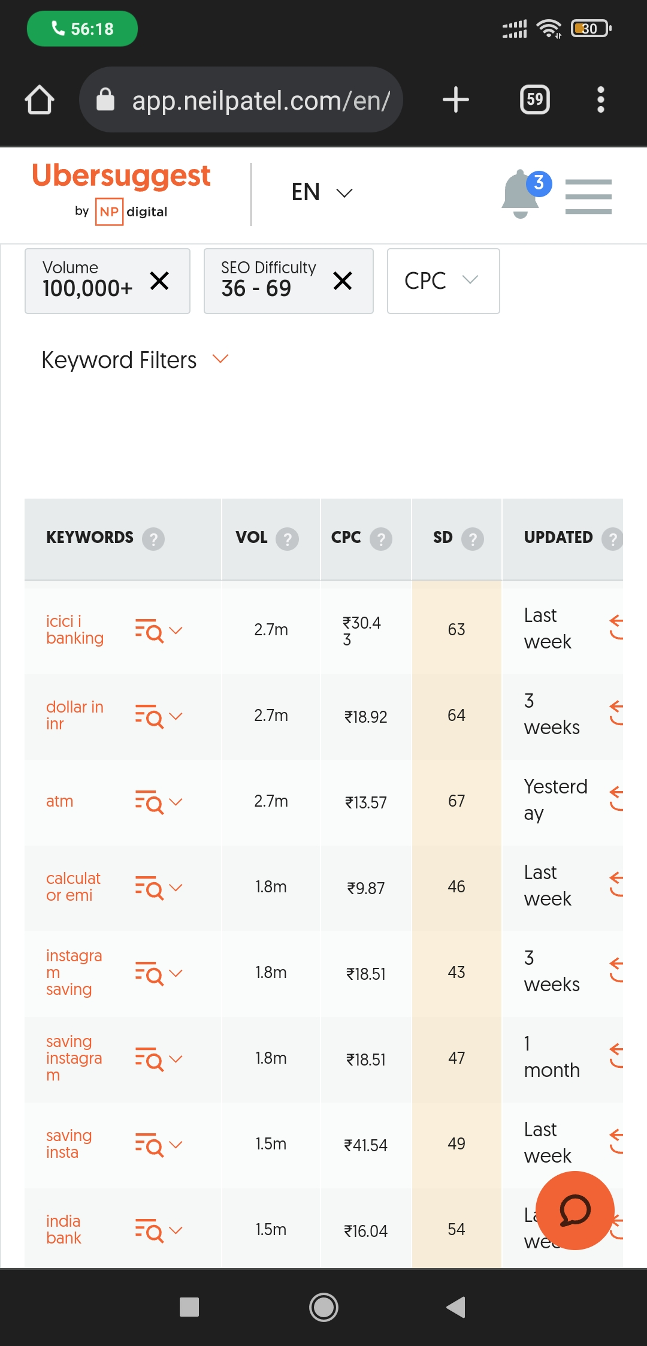
Key Insights:
'icici banking': Highly popular keyword with a large search volume and competitive market.
'dollar in inr': Good search volume, potential niche.
'atm': Moderately searched and targets travelers seeking suitable financial products.
'calculator emi': Attracts potential homeowners but faces competitive advertising.
'instagram saving': Specific audience, lower volume.
Consider prioritizing keywords with high search volume and moderate CPC for advertising.
Long-tail keywords like 'icici banking with Low Fees' may have better conversion rates with targeted audiences.
The data consists of search volume, CPC (Cost Per Click), PD (Paid Difficulty), and SD (SEO Difficulty) for each keyword.
.

Slide 18
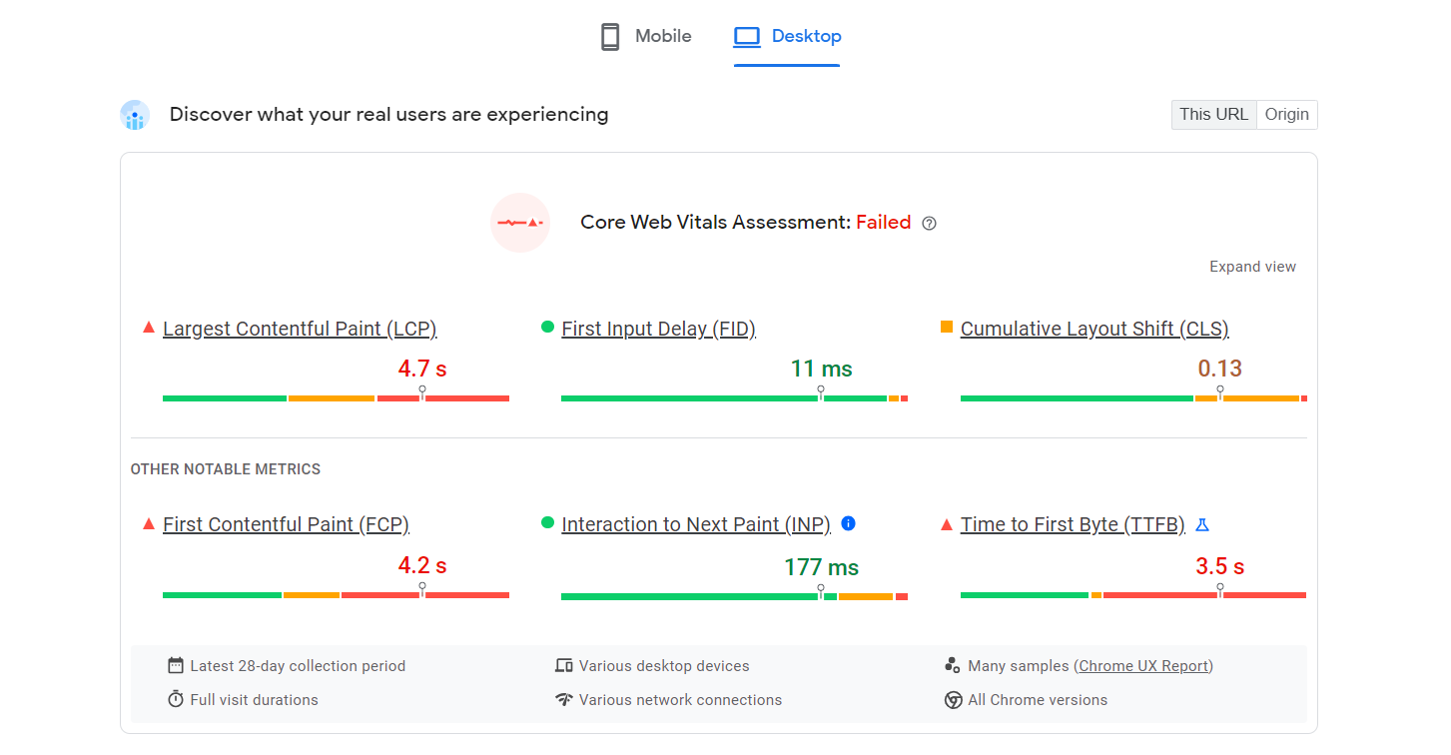
On page Optimization:

Slide 19
Page Optimization Summary:
LCP (Largest Contentful Paint): For ICICI Bank, LCP can gauge the loading speed of essential content such as account login or featured products. Speedy LCP ensures quick access for users, essential for online banking.
FID (First Input Delay): In ICICI Bank's online banking interface, FID can measure responsiveness when customers interact with elements like forms, buttons, or links. A low FID enhances the user experience, making online banking smooth and efficient.
ELS (Element Layout Shift): Though not standard, ELS likely refers to CLS. For ICICI, controlling layout shifts ensures that online banking pages appear stable, preventing accidental clicks on wrong links or buttons.
ETFB (End-to-end Feedback): Since this is not a standard term, its specific application to ICICI Bank may require further context. It could refer to the end-to-end feedback process within the bank's digital systems.
INP (Input Latency): For ICICI Bank, minimizing input latency helps make tasks like form filling and transaction processing feel responsive. Quick responses to user inputs enhance the online banking experience.
FCP (First Contentful Paint): ICICI Bank's FCP indicates how quickly users can see the first content on a page, such as login fields or promotional offers. A fast FCP contributes to the impression of a swift and efficient banking site.

Slide 20
Part 3: Content Ideas and Marketing Strategies
Content Idea Generation & Strategy:
A content calendar has been created that shows the events and campaigns the company will follow through the entire month of august in which a few were Instagram stories, posts, reels, email campaigns and such.
Objective/Aim:
Consistency
Strategic Content Planning
Time Efficiency
Content Variety
Improved Collaboration

Slide 21
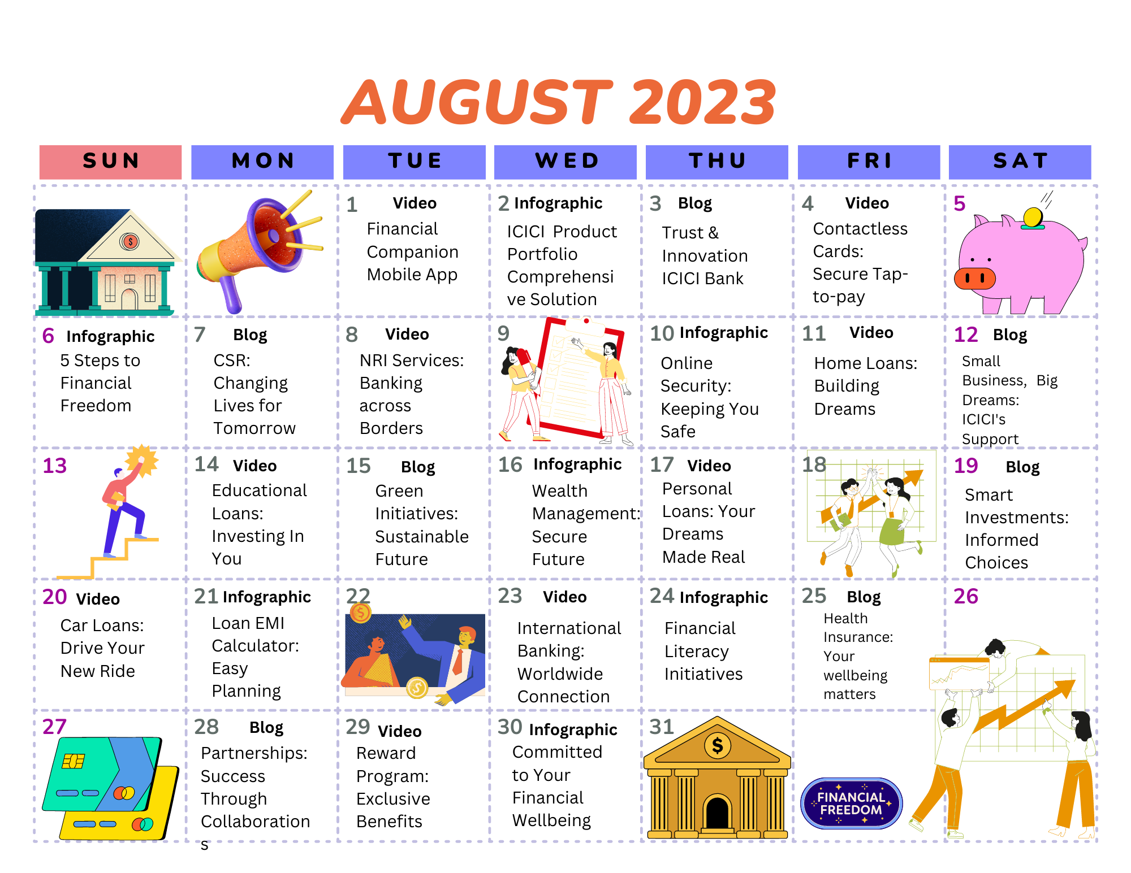

Slide 22
Part 4: Content Creation and Curation (Post creations, Designs/Video Editing, Ad Campaigns over Social Media and Email Ideation and Creation)
Post Creation:
Select Content Categories: Identify three different content formats relevant to the chosen topic or industry. Research and Brainstorm: Research trending topics, industry news, or audience interests within each category. Brainstorm ideas for social media posts that align with each category. Do note that 1 content format has to be video and additionally 3 stories/status are to be created.
Format 1: Instagram Story
Format 2: Designs/Video Editing
Format 3:Social Media Ad Campaigns

Slide 23
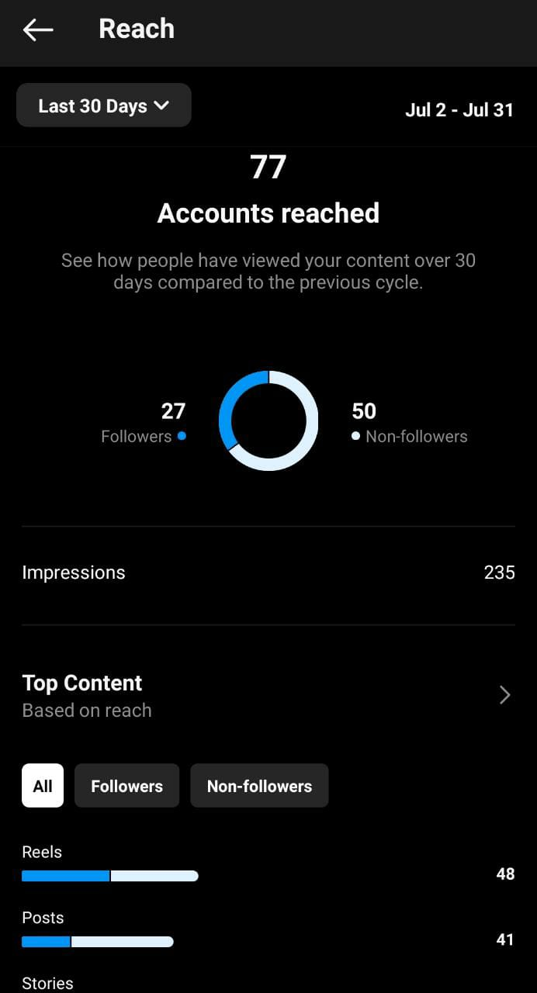
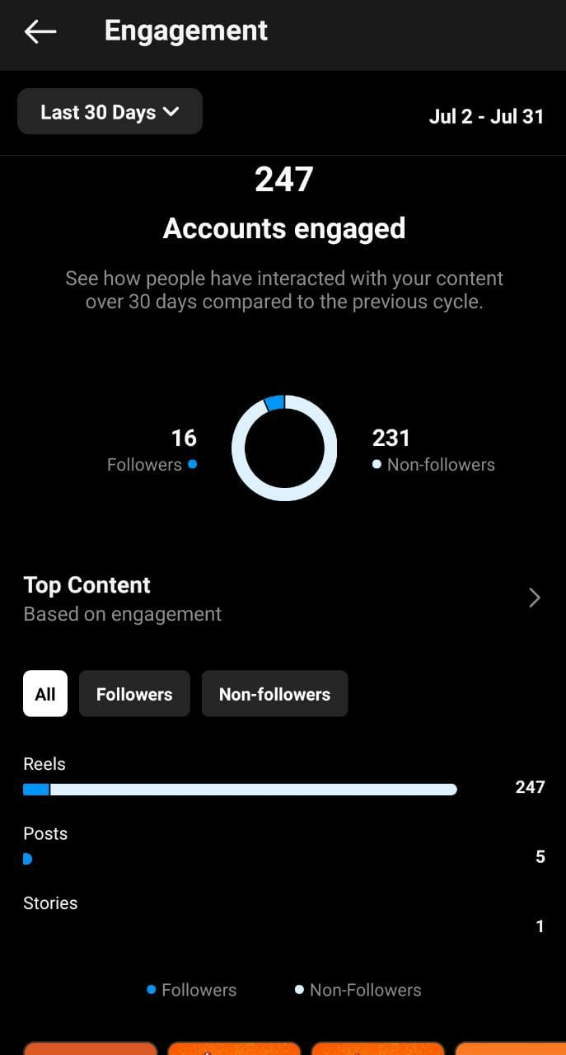
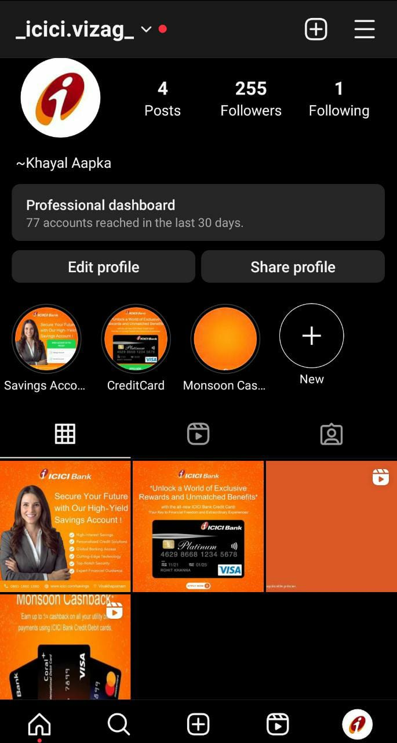
Part 4: Content Creation and Curation (Post creations, Designs/Video Editing, Ad Campaigns over Social Media and Email Ideation and Creation)
Accounts Reached
Accounts engaged
Posts/highlights/insights

Slide 24
Audience Understanding: Gain insights into your target audience's preferences, interests, and behavior to create content that resonates with them effectively.
Visual Storytelling: Leverage the power of captivating visuals, such as high-quality images and engaging videos, to tell your brand's story and connect with your audience on a deeper level.
Consistency Matters: Maintain a consistent posting schedule and stick to a cohesive content theme to build brand recognition and keep your audience engaged and interested.
Engage and Respond: Actively interact with your followers by responding to comments, messages, and mentions. Building genuine connections with your audience fosters a sense of community and loyalty.
Embrace Instagram Features: Stay up-to-date with the latest features and tools offered by Instagram and experiment with them to stay relevant, leverage trends, and enhance your social media strategy.
Post Creation:
Format 1: Instagram Story
Aim: To increase engagement and keep
customers updated.
Idea: Increase website traffic by posting
relatable and attractive content
Links: click here for the Instagram profile

Slide 25
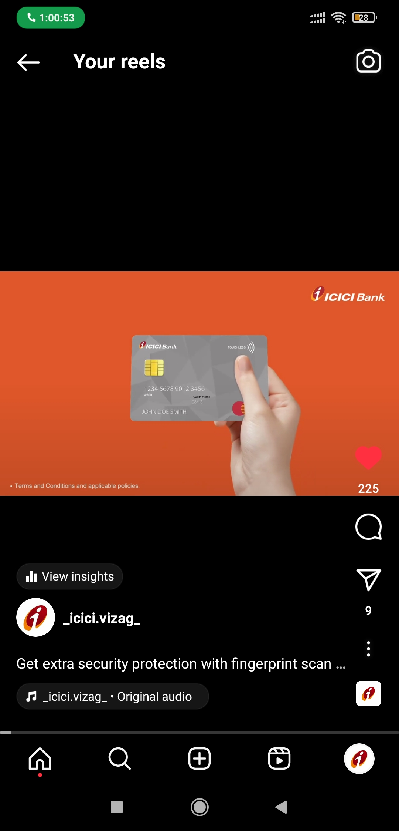
Part 4: Content Creation and Curation (Post creations, Designs/Video Editing, Ad Campaigns over Social Media and Email Ideation and Creation)
Post Creation:
Format 2: Video
Aim: To provide Convinent and Secure payment option, while offering
various benefits.
Date: 31st July 2023
Idea: We enhanced features of ICICI Credit Cards.
Topic: The latest features of ICICI Credit Cards.
Links: click here for the video
click here for the Instagram reel
Caption: "Get extra security protection with fingerprint scan app with
ICICI bank. Grab your cards for endless shopping hassle free. Apply now!!!!
~Khayal Aapka

Slide 26
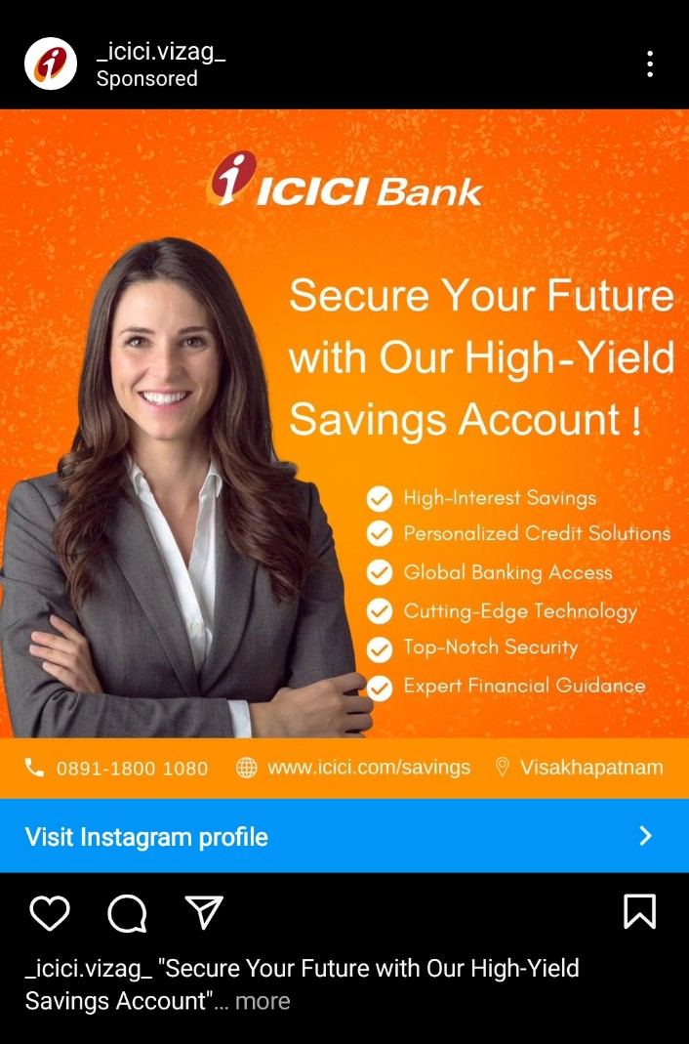
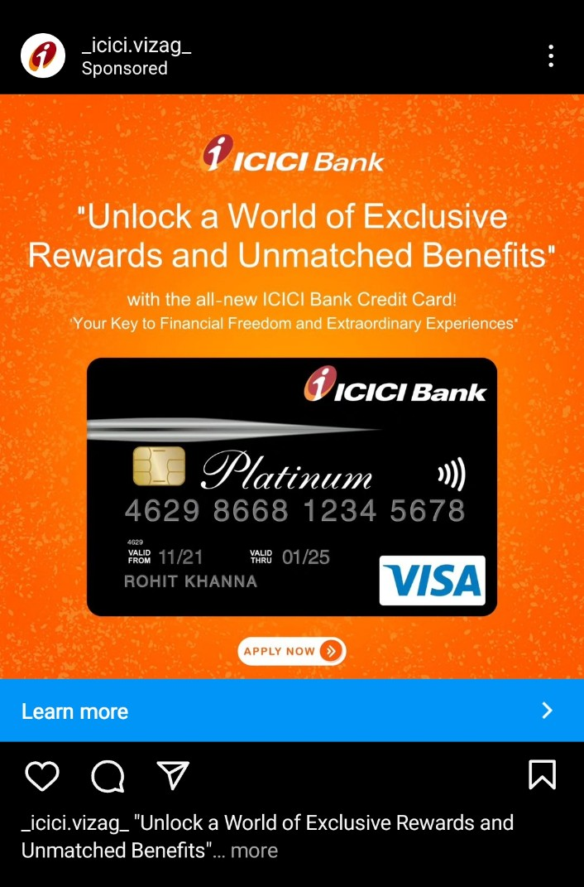
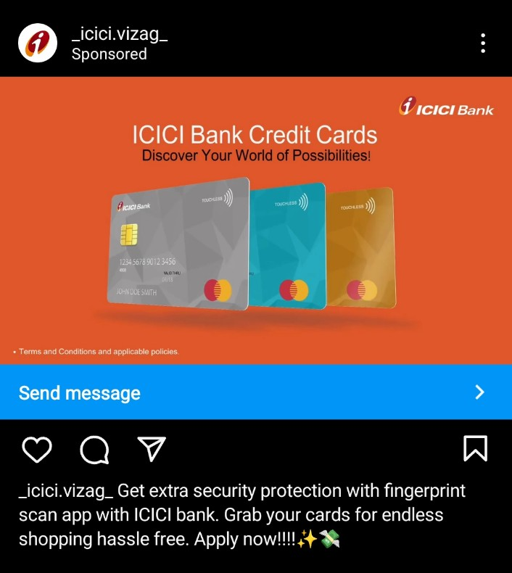
Part 4: Content Creation and Curation (Post creations, Designs/Video Editing, Ad Campaigns over Social Media and Email Ideation and Creation)
Objectives of Instagram campaign:
View Instagram Page
Promote Products and services
Increase Brand Awarness
Generate leads

Slide 27
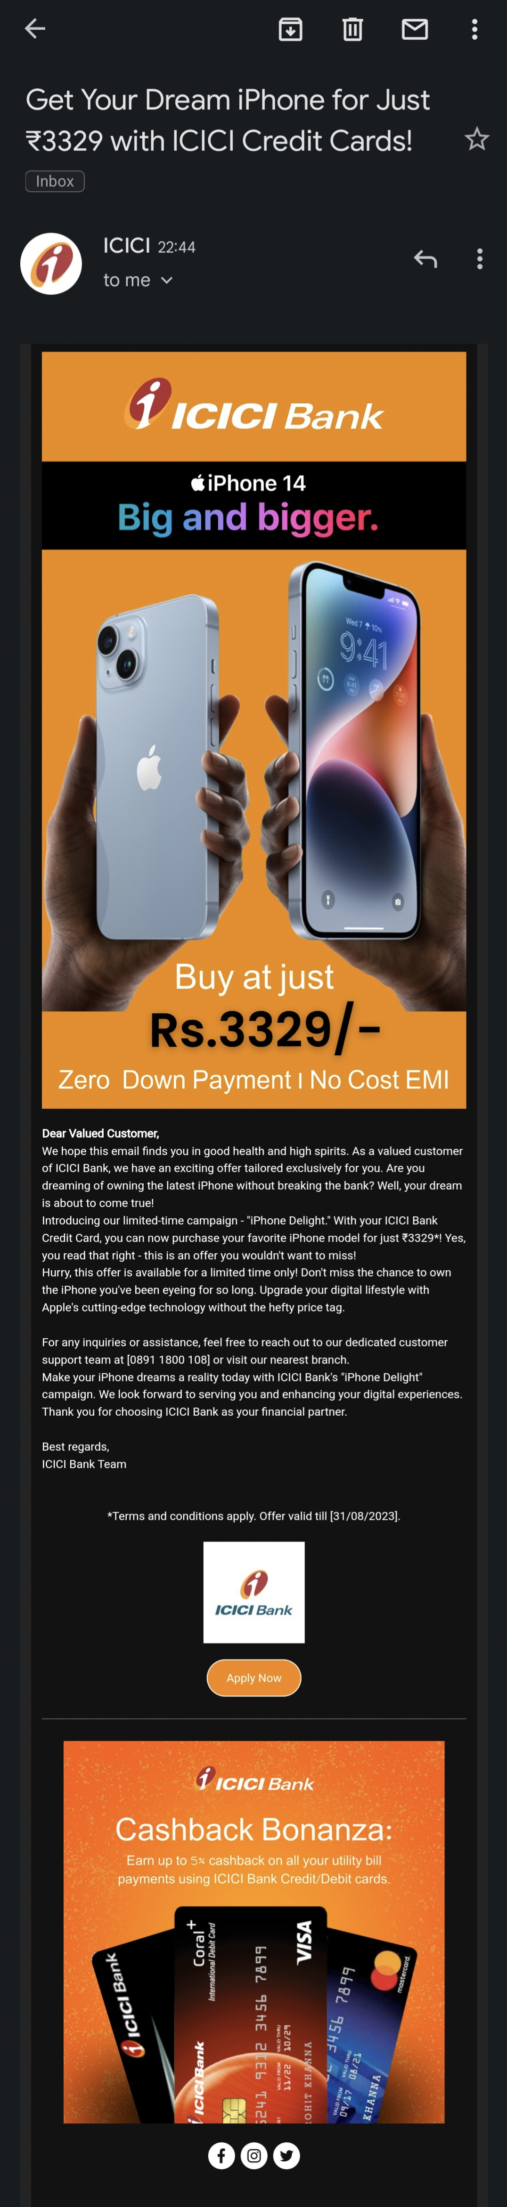
Email Ad Campaigns
Ad Campaigns for email marketing:
One for lead generation and the other for brand awareness. These campaigns were then sent via Gmail. Each email was crafted with creative ideas, and the most significant challenge was working within the limitations of the free version of Mailchimp. Nevertheless, we maximized the website's capabilities to their full potential, ensuring the success of both campaigns.

Slide 28
Email Ad Campaign 1 - Brand Awareness
Our email prominently highlights the attractive offer of the latest "iPhone 14" at 3329/- with ICICI credit card no-cost EMI. This deal is presented clearly, making it irresistible for potential customers. Background elements were added for a pop of color, enhancing its visual appeal and drawing attention to the exciting offer. Additionally, the ICICI logo is clearly displayed, representing the bank effectively.
Website used: Mailchimp
View full Mail

Slide 29
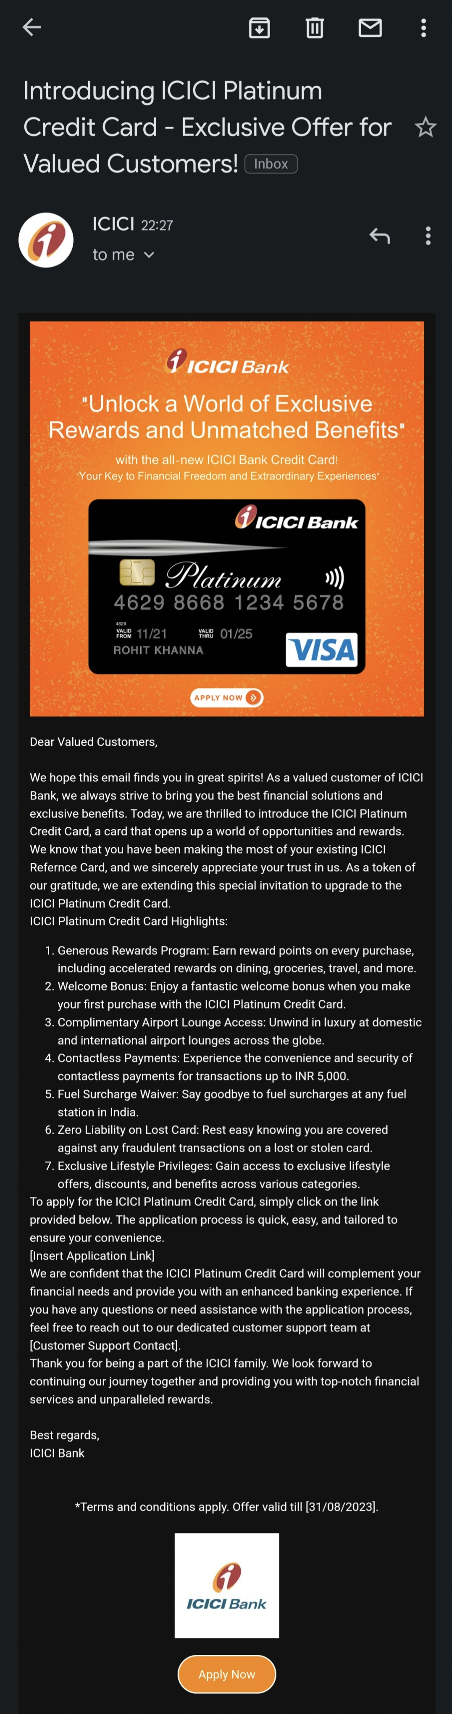
Email Ad Campaign 2 - Lead Generation
The Mailchimp website is used for creating email campaigns, our email prominently encourages to sign up by highlighting comfortable and sustainable fashion of Bata.Background elements were added for a pop of color, enhancing its visual appeal. Additionally, the logo is clearly displayed, representing the brand effectively. Furthermore, each email's subject is well-defined, helping to convey the purpose of the mail clearly. With its user-friendly interface (such as links of social pages were added) and attention to design.
Website used: Mailchimp
View full Mail

Slide 30
Part 4: Content Creation and Curation (Post creations, Designs/Video
Editing, Ad Campaigns over Social Media and Email Ideation and Creation)
Lessons Learned from ICICI Digital Marketing Internship:
Effective audience segmentation enhances the relevance of content and messaging for ICICI Bank's diverse customer base.
Consistent monitoring and data analysis are crucial in optimizing the performance of digital marketing campaigns.
Continuous optimization is essential to ensure the success of each digital marketing initiative.
Challenges Faced during ICICI Digital Marketing Internship:
Limited access to full versions of the bank's website and digital platforms impacted the ability to track customer journeys accurately.
Ad fatigue was a common issue, requiring regular creative updates to maintain audience interest.
Implementing robust tracking and attribution models was challenging but necessary to address the limitations of customer journey tracking.

